Slide 1
Mini Project 2 :
Marketing Strategy – Customer Segmentation
Presentation by:
Madhu Nuthula
Date: 13/12/2022

Slide 2
Problem Statement
Requirement of a retail company - to segment the customers based on the total amount they spent so the company can market particular products based on the customer's expenditure level to maximize the sales and ROI(Return on Investment)
Why?
Customer personality analysis helps a business to modify its product based on its target customers from different types of customer segments. For example, instead of spending money to market a new product to every customer in the company’s database, a company can analyze which customer segment is most likely to buy the product and then market the product only on that particular segment.
Marketing is crucial for your company’s success – you have to spend money to make money. If you’re not marketing your business, you’re not making progress

Slide 3
Market Study
According to the U.S. Small Business Administration, small businesses generally want to spend between 7-8% of their revenue on marketing
Deloitte found that both B2B product and B2C service industries spend around 10% of their budget on marketing
In comparison, B2C product and B2B service industries spent as much as 15-18% on their marketing.
Return on Investment (ROI)
A good marketing ROI is 5:1 — or $5 for every $1 spent.
An outstanding ROI is 10:1, where you get $10 for every $1 spent.

Slide 4
Project Structure
Data Acquisition &
Cleaning
Modelling
Exploratory Data Analysis
Compare & Identify the Best Model
Summarize and Suggest

Slide 5
Dataset Details:
Dataset | From Kaggle
Features | 29
Observations | 2240
Data types | float64(1), int64(25), object(3)
Numerical Features | 26
Discrete features | 16
Continuous features | 10
Categorical features | 3
Binary Categorical features | 0
Reference: https://www.kaggle.com/datasets/whenamancodes/customer-personality-analysis

Slide 6
Features & Target
People
ID: Customer's unique identifier
Year_Birth: Customer's birth year
Education: Customer's education level
Marital_Status: Customer's marital status
Income: Customer's yearly household income
Kidhome: Number of children in customer's household
Teenhome: Number of teenagers in customer's household
Dt_Customer: Date of customer's enrollment with the company
Recency: Number of days since customer's last purchase
Complain: 1 if the customer complained in the last 2 years, 0 otherwise
Products
MntWines: Amount spent on wine in last 2 years
MntFruits: Amount spent on fruits in last 2 years
MntMeatProducts: Amount spent on meat in last 2 years
MntFishProducts: Amount spent on fish in last 2 years
MntSweetProducts: Amount spent on sweets in last 2 years
MntGoldProds: Amount spent on gold in last 2 years
Promotion
NumDealsPurchases: Number of purchases made with a discount
AcceptedCmp1: 1 if customer accepted the offer in the 1st campaign, 0 otherwise
AcceptedCmp2: 1 if customer accepted the offer in the 2nd campaign, 0 otherwise
AcceptedCmp3: 1 if customer accepted the offer in the 3rd campaign, 0 otherwise
AcceptedCmp4: 1 if customer accepted the offer in the 4th campaign, 0 otherwise
AcceptedCmp5: 1 if customer accepted the offer in the 5th campaign, 0 otherwise
Response: 1 if customer accepted the offer in the last campaign, 0 otherwise
Place
NumWebPurchases: Number of purchases made through the company’s website
NumCatalogPurchases: Number of purchases made using a catalogue
NumStorePurchases: Number of purchases made directly in stores
NumWebVisitsMonth: Number of visits to company’s website in the last month
Target
Customer segmentation based on the amount spent into three levels
Low
Med
High

Slide 7
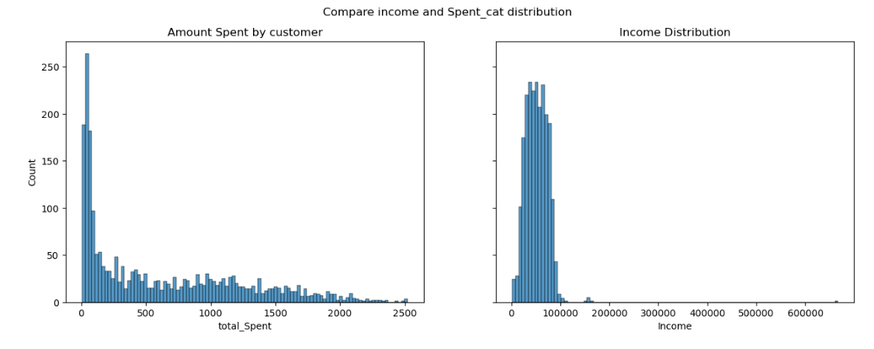
EDA Visuals

Slide 8
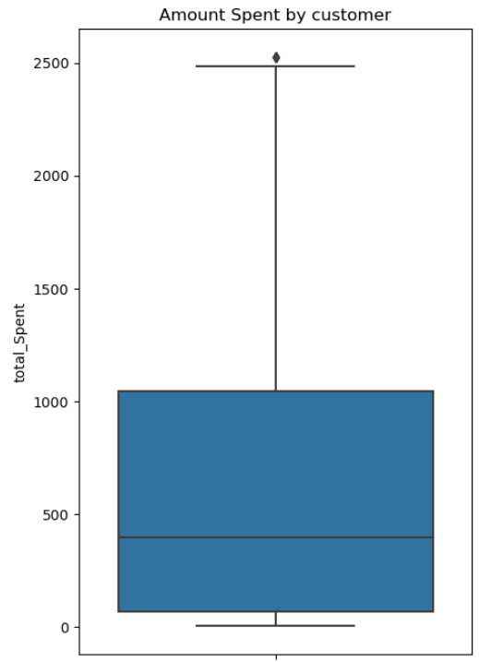
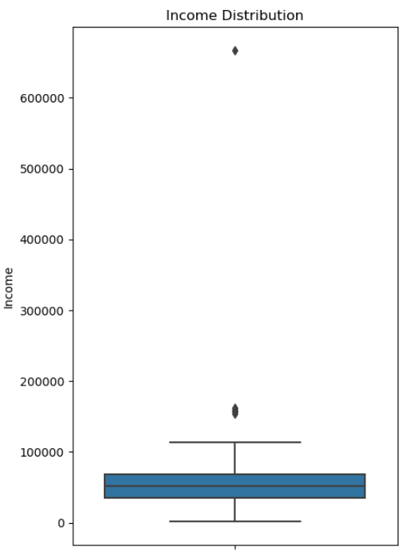
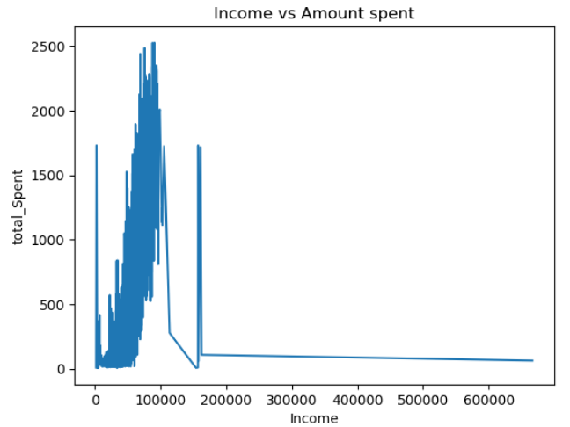
EDA - Outliers

Slide 9
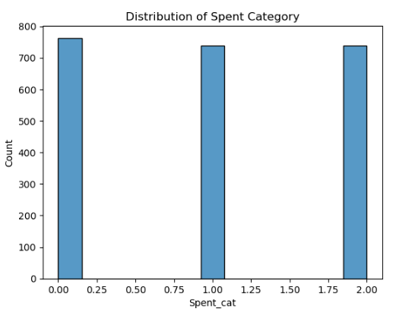
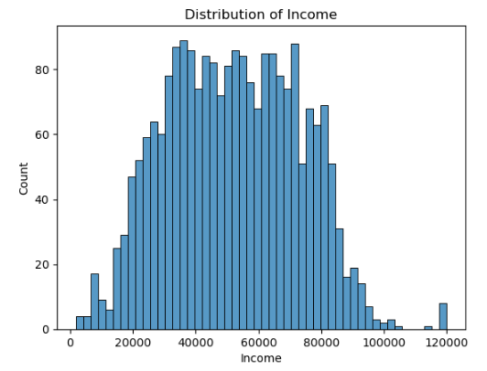
EDA Visuals
0 : Low Spent, 1 : Med Spent, 2: High Spent

Slide 10
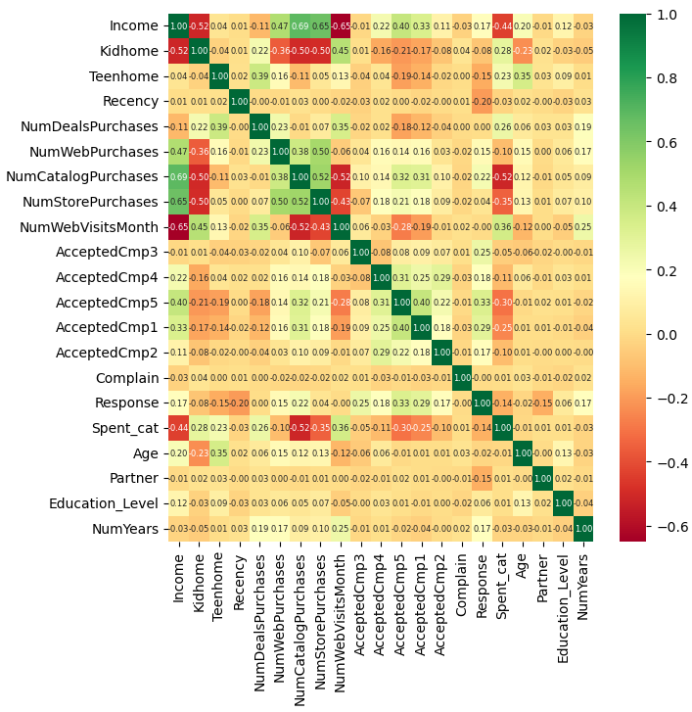
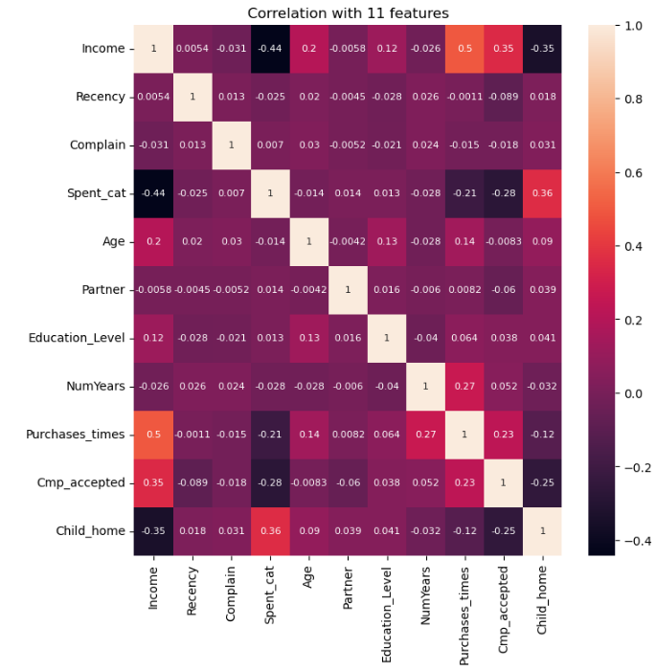
Correlation Matrix

Slide 11
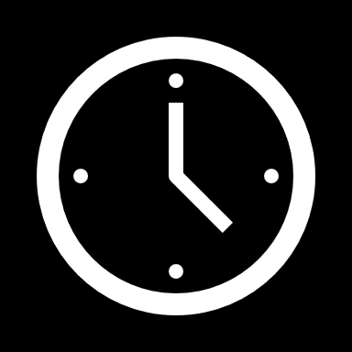
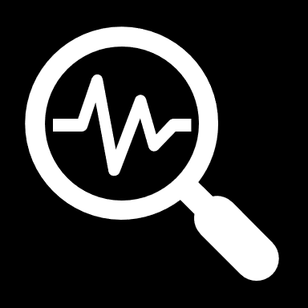
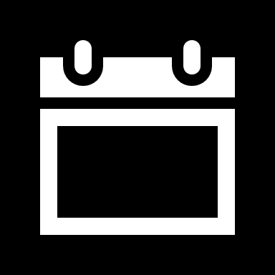
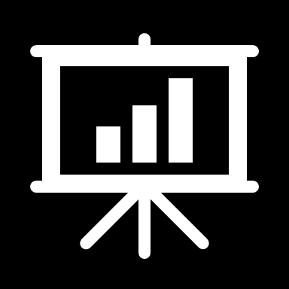
Challenges:
Categorize
Target to Expenditure Levels
Education level from 5 to 3 levels
Partner Status from 8 to 2
Reduce features and still keep the data by feature engineering
29 features to 11
Date To Years
Convert DOB to Age
Dimension Reduction
Remove Outliers
Evaluate Models
Customers spent over 2500 are 3; replaced to 2500
Income - Only 8 customers over 120,000; replaced them to 120,000
Logistic Regression
Support Vector Machines
Naïve Bayes
Date customer joined to years with Company

Slide 12
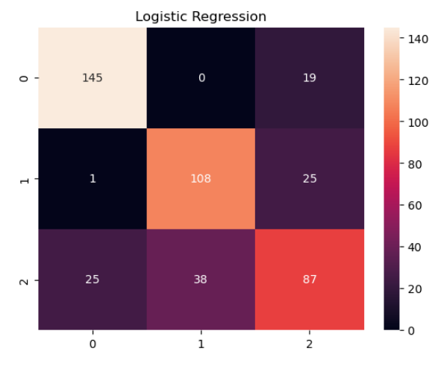
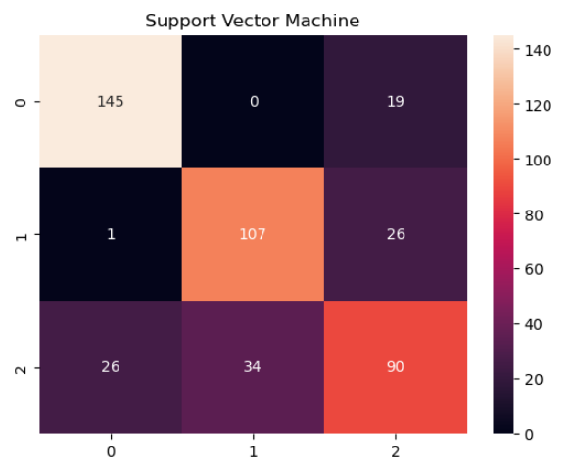
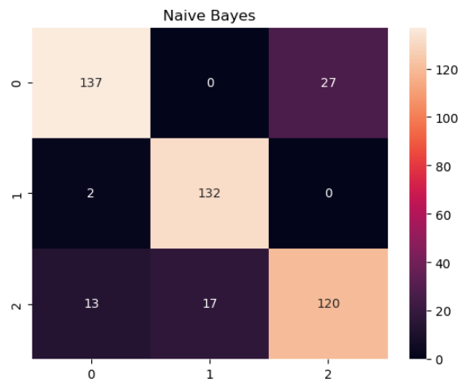
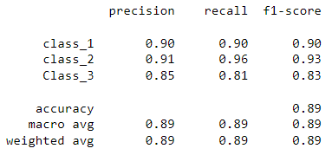
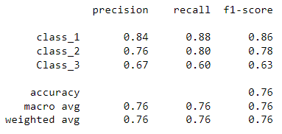
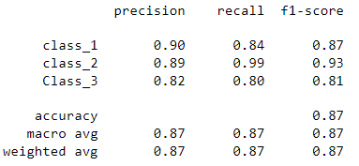
Confusion Matrix with all columns

Slide 13
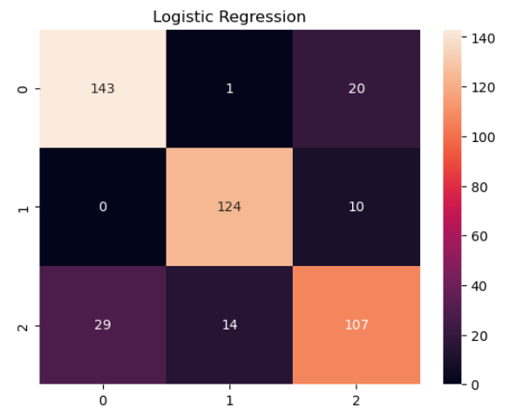
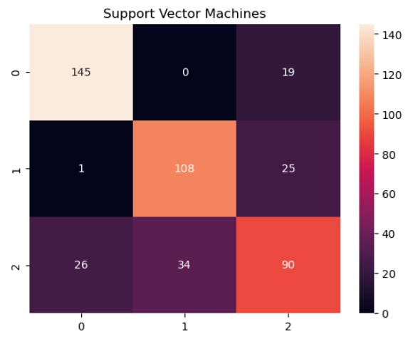
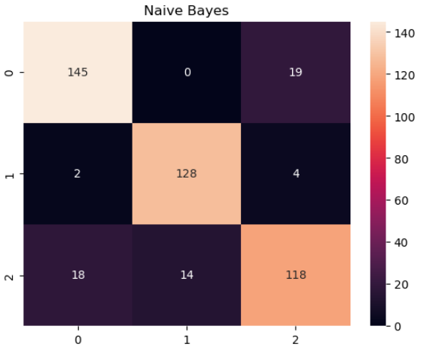
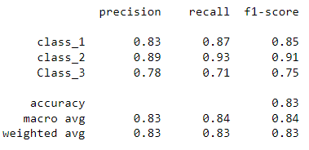
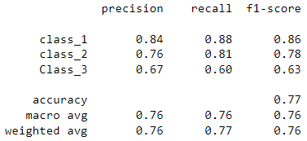
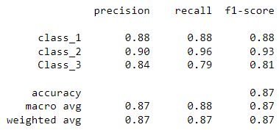
Confusion Matrix with 11 Columns

Slide 14
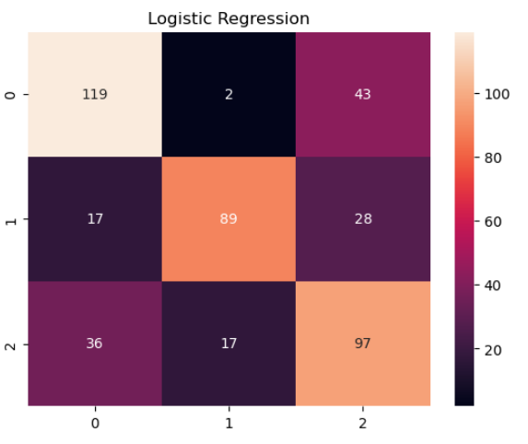
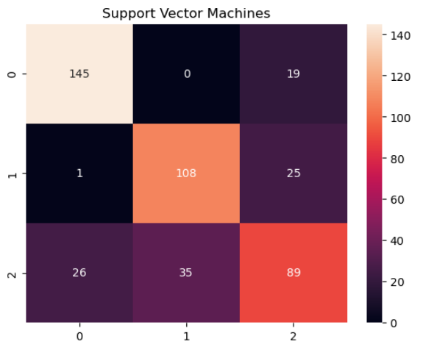
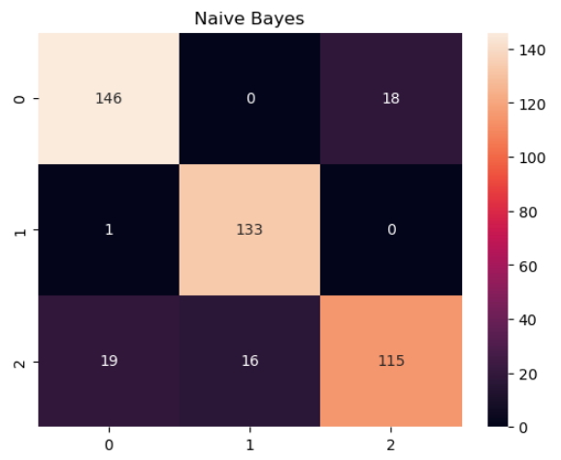
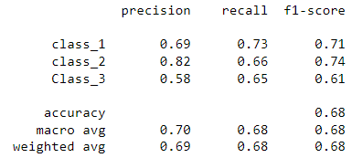
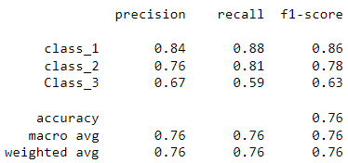
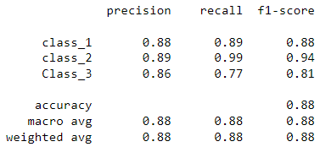
Confusion Matrix 5 Columns

Slide 15
Summary
Naïve Bayes Model provides the best results
with accuracy of 0.88 with 4 features
Since we can target the targeted audience with 88% accurately segmented customers;
The proposed model will help:
Improves customer experience and satisfaction
Increase turnover
Stakeholder can get high ROI
Can invest with confidence in Marketing

Slide 16
References
https://www.kaggle.com/datasets/whenamancodes/customer-personality-analysis
https://www.kaggle.com/code/mauricioasperti/automobile-customer-segmentation-classification
https://www.synx.com.au/blog/what-percentage-of-revenue-should-you-spend-on-marketing

Slide 17
Thank you
End of Presentation

